Slide 1
Customer Segmentation
Using K-Means and DBSCAN Clustering: A Comparative Study
- Abhishek Puppala, Neelapu Tirumalesh Reddy, Deval Shaileshkumar Mali, Jashwanth Kalyan Polavarapu

Slide 2
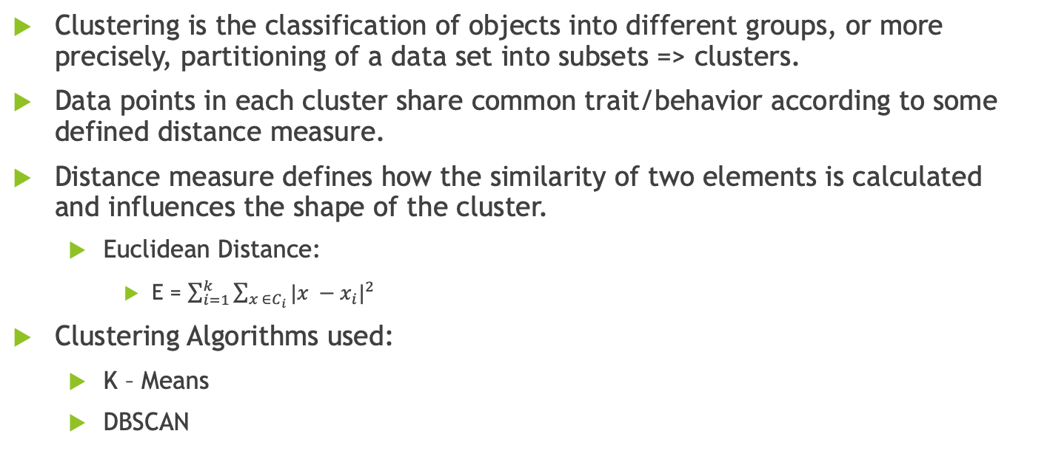
Clustering
Clustering is the classification of objects into different groups, or more precisely, partitioning of a data set into subsets => clusters.
Data points in each cluster share common trait/behavior according to some defined distance measure.
Distance measure defines how the similarity of two elements is calculated and influences the shape of the cluster.
Euclidean Distance:
E = $\sum_{i=1}^{k}{\sum_{x ∈C_{i}}{{|x −x_{i}|}^{2}}}$
Clustering Algorithms used:
K – Means
DBSCAN

Slide 3
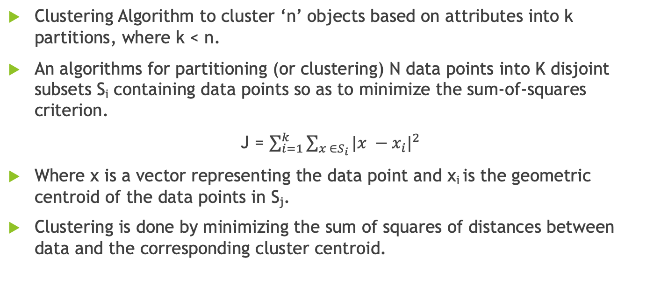
K – Means Clustering
Clustering Algorithm to cluster ‘n’ objects based on attributes into k partitions, where k < n.
An algorithms for partitioning (or clustering) N data points into K disjoint subsets S_{i} containing data points so as to minimize the sum-of-squares criterion.
J = $\sum_{i=1}^{k}{\sum_{x ∈S_{i}}{{|x −x_{i}|}^{2}}}$
Where x is a vector representing the data point and x_{i} is the geometric centroid of the data points in S_{j}.
Clustering is done by minimizing the sum of squares of distances between data and the corresponding cluster centroid.

Slide 4
DBSCAN Clustering
DBSCAN for Density-Based Spatial Clustering of Applications with Noise
Density based clustering locates regions of high density that are separated from one another by regions of low density.
Density = number of points within a specified radius (eps)
Algorithm:
Input => N objects to be clustered and global parameters Eps, MinPts.
Output => Cluster of objects.

Slide 5
Customer Segmentation
Customer segmentation helps the organizations/companies understand their customer base and can target or design new products specific to a sub-group of the customers.
Business can determine which niche market best fits the unique product they produce, which enables the business to maintain a sizable market share and maintain its competitive edge over other market participants.
Segmentation can be achieved focusing on different attributes such as behavioral, geographic, demographic etc.,
Segmentation focuses on behavioral data as it is the most efficient and practical one.

Slide 6
RFM Analysis
RFM known for the values based on Recency, Frequency and Monetary.
Recency:
Refers to how often times a customer awaits before making subsequent purchase.
Frequency:
Measurement of how frequently a customer made a purchase over a given time frame.
Higher values suggests that clients are more devoted to the business, while the lower values suggests the opposite.
Monetary:
Money spent by a consumer during the specified time period.

Slide 7
Customer Segmentation using Online Retail Dataset
Dataset Link: https://archive.ics.uci.edu/ml/datasets/online+retail
Attributes:
InvoiceNo – Six digit unique number for each transaction.
StockCode – Discrete value allocated to each individual product.
Description – Name or Description of the item.
Quantity – Volume of each purchase made in a single trade.
InvoiceDate – Timestamp when the invoice was generated.
UnitPrice – Production cost of the goods.
CustomerID – Each user is identified by a distinct autoincremented number.
Country = Country Name, title of the nation in which the client lives.

Slide 8
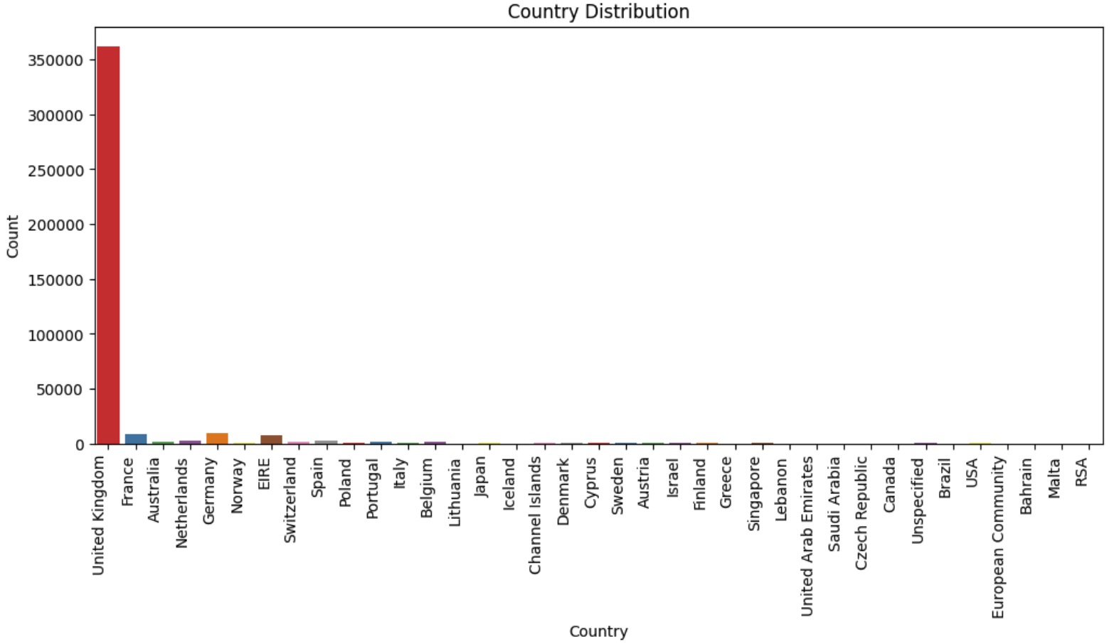
Country Distribution – Outliers
United Kingdom comprises of 98% data and all the other countries data is considered as outliers and dropped from the dataset

Slide 9
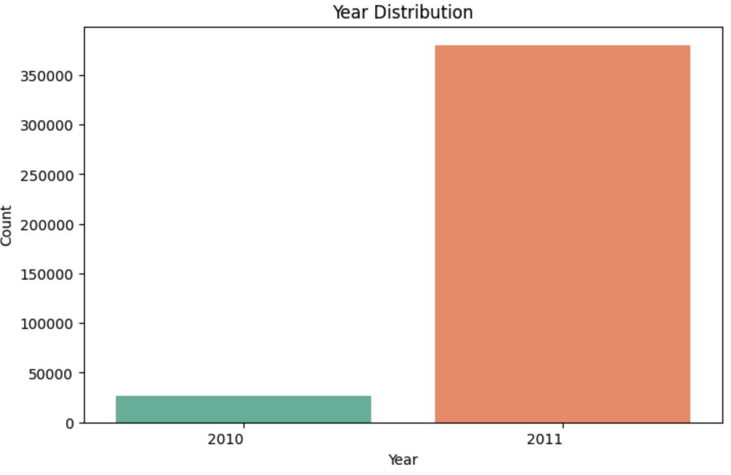
Year Distribution – Outliers contd.
Year 2010 data is dropped from the dataset as it is not having enough volume.

Slide 10
RFM Values Calculation
Recency
InvoiceDate attribute provides the date information when the customer purchased.
Max InvoiceDate of the entire dataset is calculated as most recent transaction date.
Frequency
For Each customer, no (count) of transactions made in the dataset is calculated.
Calculated value is named as Frequency.
Monetary
UnitPrice and Quantity attributed are multiplied to calculate the amount spent by the customer for each transaction.
For each customer total amount spent is calculated by using sum function.
Applying min function for each customer on the calculated date column gives the Recency of the customer.
Max transaction date and customer invoice date difference is calculated.
Aggregated amount spent is termed as Monetary.

Slide 11
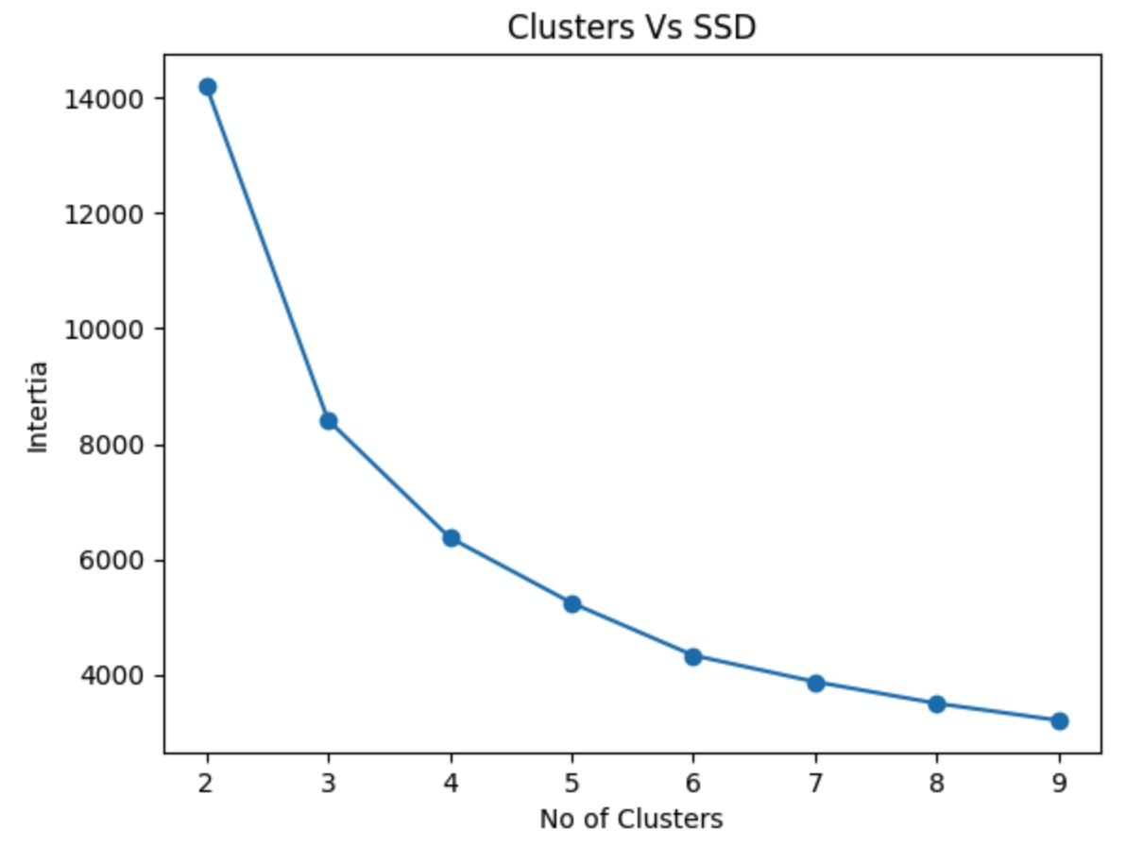
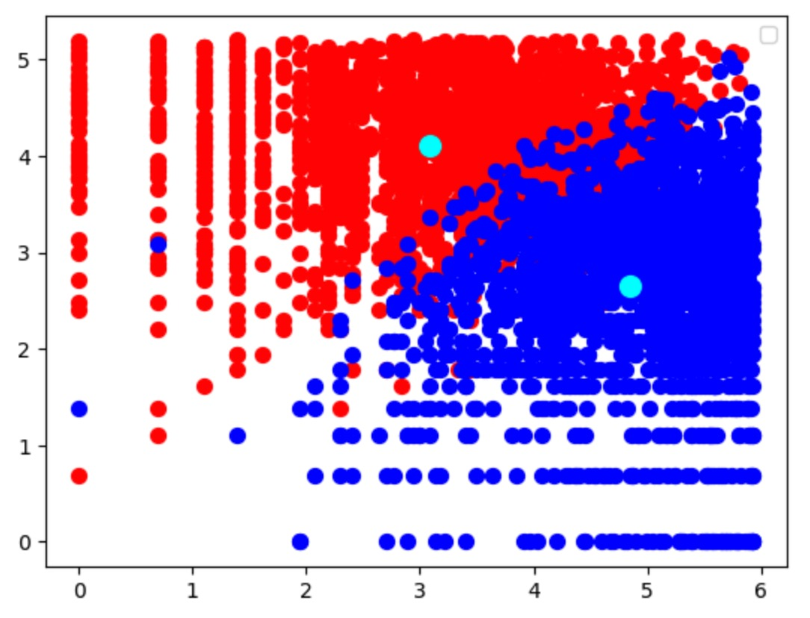
K – Means Clustering

Slide 12
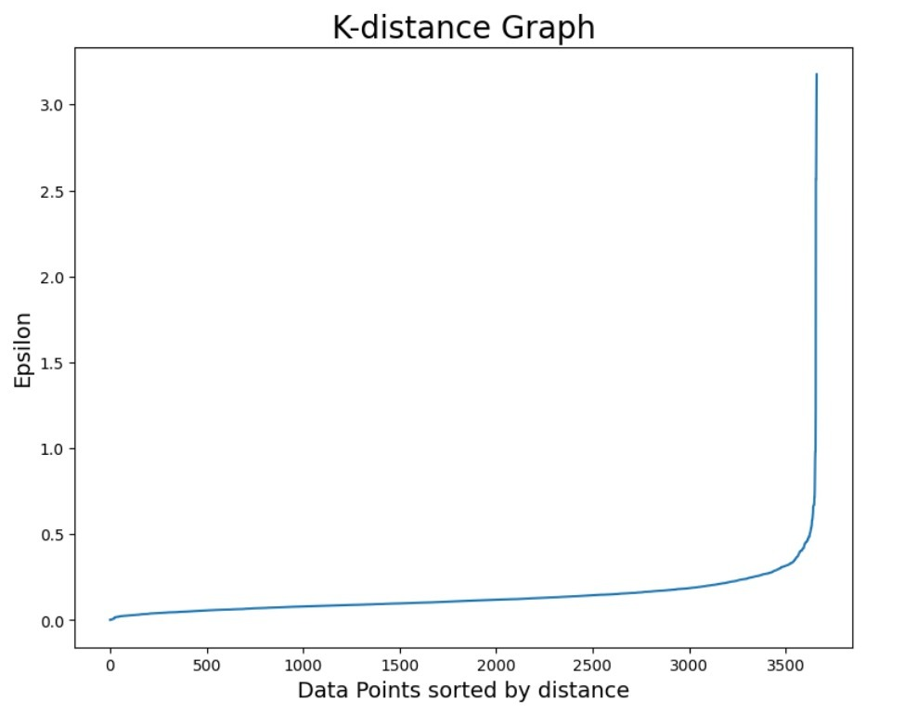
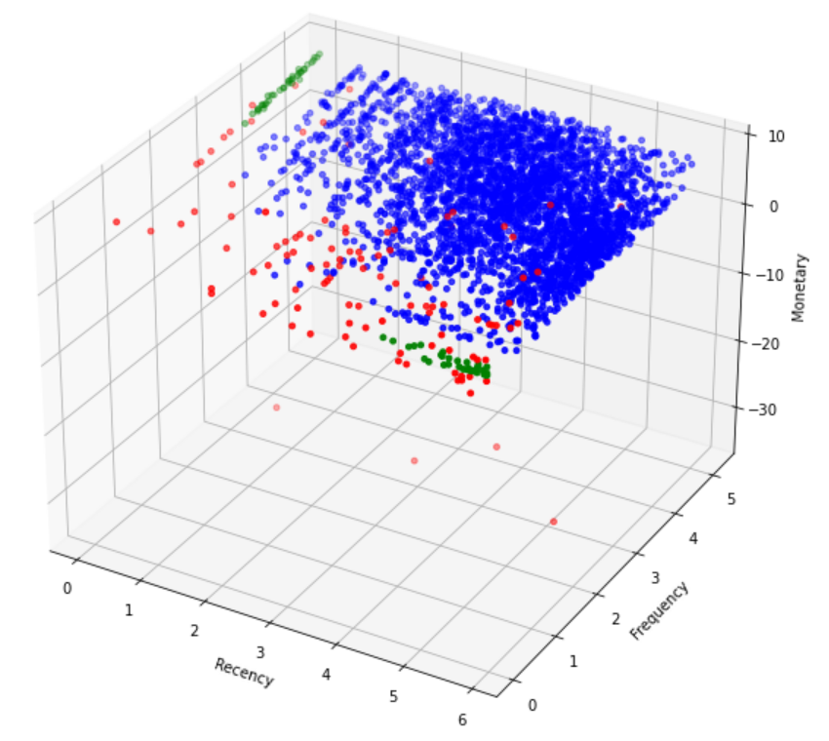
DBSCAN Clustering

Slide 13
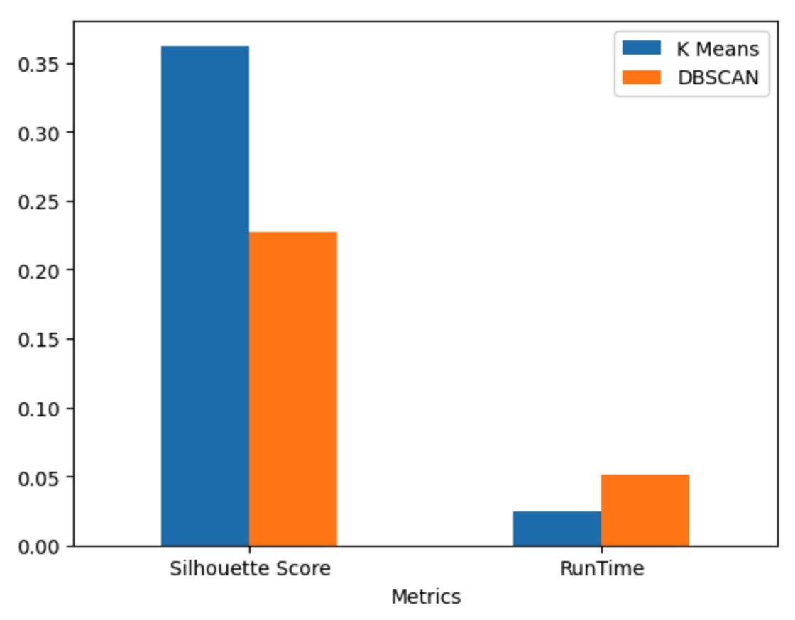
Results

Slide 14
Conclusion
For the selected Dataset with RFM values, K-Means algorithm performed better generating the clusters than DBSCAN.
Comparison done based on the silhouette scores of the formed clusters
Time taken to model the data and form the clusters.
K – Means is faster than DBSCAN most times.

